Slide 1
RNA seq analysis discussion
4-21-20

Slide 2
Inconsistencies within GSEA analysis?
Description | setSize | EnrichmentScore | NES | pvalue | p.adjust | qvalues
positive regulation of MAPK cascade | 311 | 0.381324149 | 1.59353213 | 0.00011409 | 0.008534384 | 0.00696
negative regulation of MAPK cascade | 131 | 0.412243875 | 1.56596362 | 0.00224066 | 0.038562919 | 0.03144
Inconsistencies between IPA and GSEA analysis?
Description | setSize | EnrichmentScore | NES | pvalue | p.adjust | qvalues
Glioma | 66 | 0.58179773 | 1.93175427 | 5.92E-05 | 0.00897962 | 0.00714236
double-strand break repair via homologous recombination | 104 | 0.443346729 | 1.62977689 | 0.00147447 | 0.031198956 | 0.02543
Pathway | LMP vs. Control | Olaparib vs. Control | LMP400 + Olaparib vs. Control
Glioma Signaling | -0.471 | 1.633 | -0.784
DNA Double-Strand Break Repair by Homologous Recombination | N/A | N/A | N/A
Should we focus on IPA or GSEA?

Slide 3
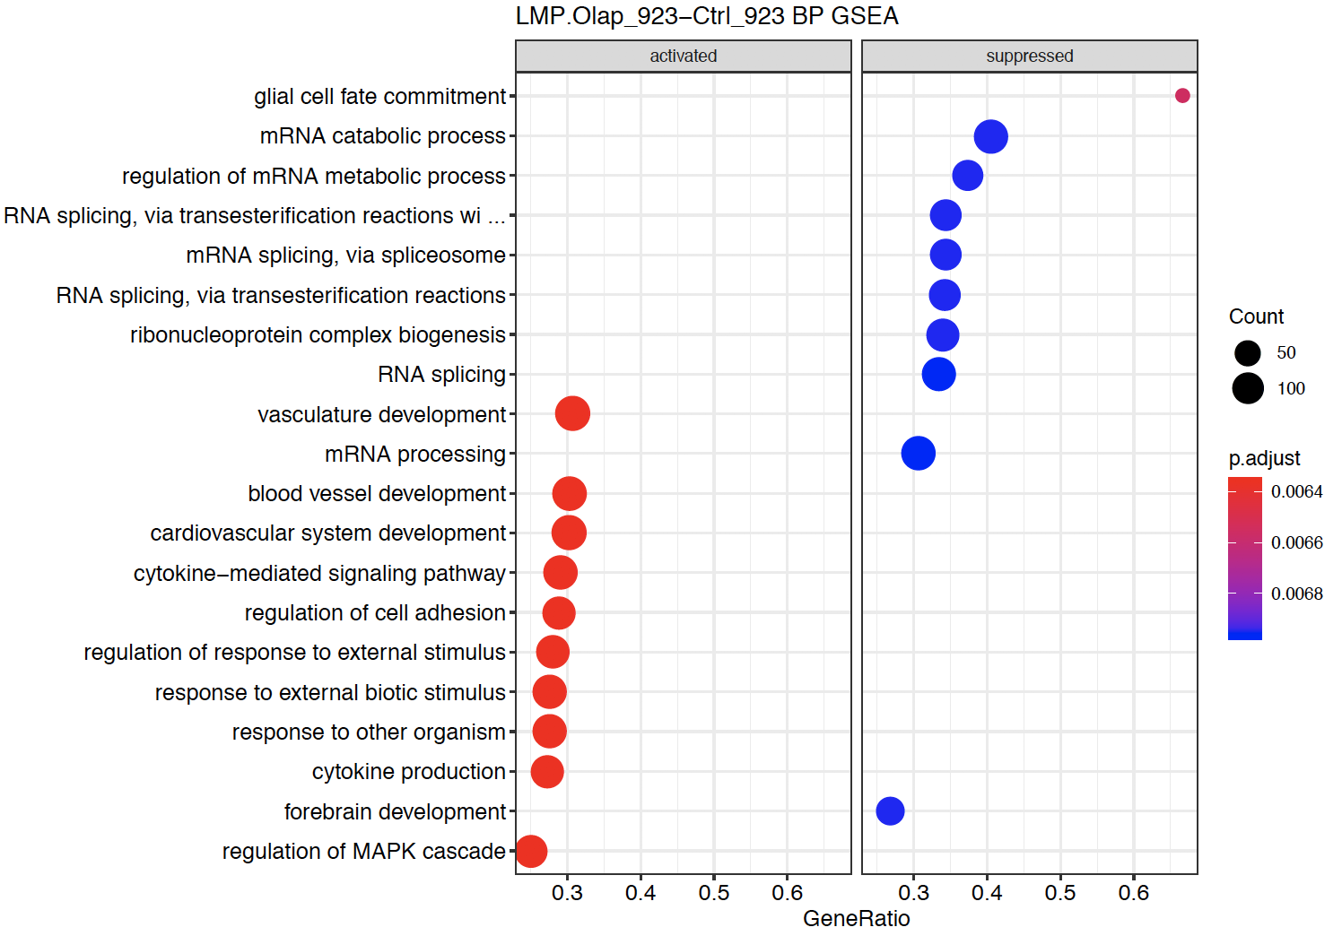
GSEA analysis of Control vs. LMP400+Olaparib in GSC923 Top 10 significant pathways from CCBR
Glial cell fate commitment rank in Excel file is 218
What does the “rank” mean? Should there be a pathway ranked #1 in this list?

Slide 4
IPA analysis of Control vs. LMP400+Olaparib in GSC923
Ingenuity Canonical Pathways | p-value | z-score
Role of BRCA1 in DNA Damage Response | 6.31E-13 | 1.732
Cell Cycle: G1/S Checkpoint Regulation | 5.37E-10 | -1.061
ATM Signaling | 3.98E-08 | 2
Role of CHK Proteins in Cell Cycle Checkpoint Control | 9.77E-08 | 0
Cyclins and Cell Cycle Regulation | 1.12E-07 | 0.816
p53 Signaling | 1.82E-07 | 0.343
Cell Cycle Control of Chromosomal Replication | 3.89E-06 | 2.887
DNA Double-Strand Break Repair by Homologous Recombination | 5.75E-06 | #NUM!
Cell Cycle: G2/M DNA Damage Checkpoint Regulation | 3.47E-05 | 0.426
Glioma Signaling | 4.57E-05 | -0.784
Death Receptor Signaling | 7.59E-05 | 1.715
Ingenuity Canonical Pathways | p-value | z-score
PTEN Signaling | 0.000302 | 2.402
Glioblastoma Multiforme Signaling | 0.000195 | 0.885
PI3K/AKT Signaling | 0.000525 | -0.457
NF-κB Signaling | 0.000955 | -1.511
Myc Mediated Apoptosis Signaling | 0.003715 | 1.147
Apoptosis Signaling | 0.004467 | 1.671
NER Pathway | 0.004571 | 1.961
ERK/MAPK Signaling | 0.005888 | 1.941
Endoplasmic Reticulum Stress Pathway | 0.017783 | -2.121
NRF2-mediated Oxidative Stress Response | 0.002188 | -2.414

Slide 5
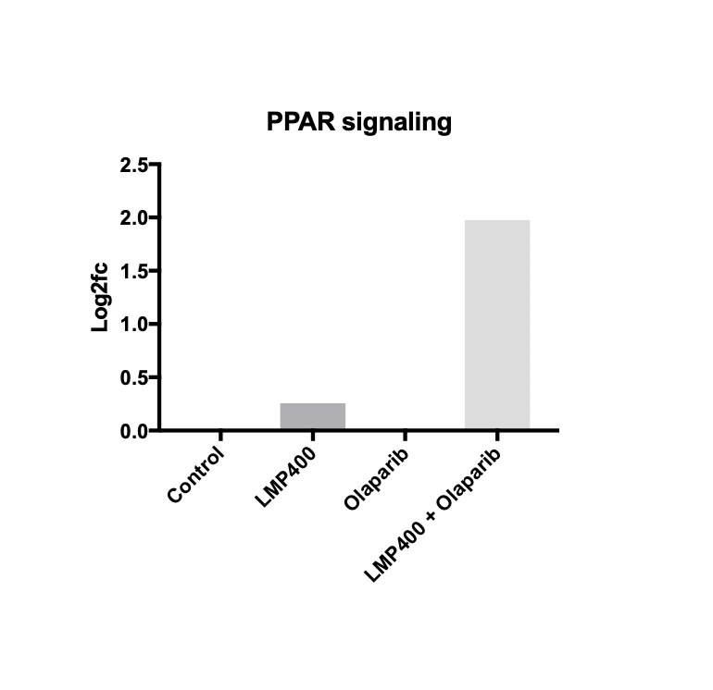
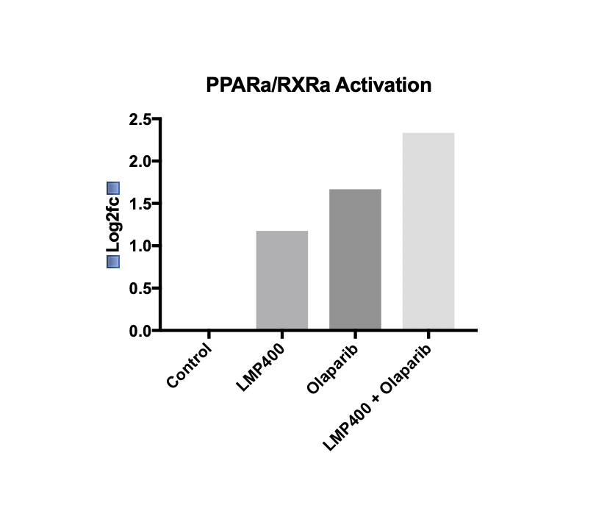
IPA analysis (GSC923)
 | LMP vs. Control | Ola vs. Control | LMP+Ola vs. Control
PPARα/RXRα Activation | 1.177 | 1.667 | 2.335
 | LMP vs. Control | Ola vs. Control | LMP+Ola vs. Control
PPAR Signaling | 0.258 | 0 | 1.976
What is the difference between 0 and N/A in the IPA results?

Slide 6
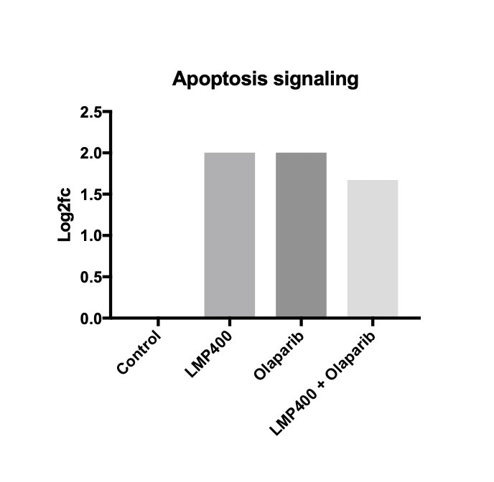
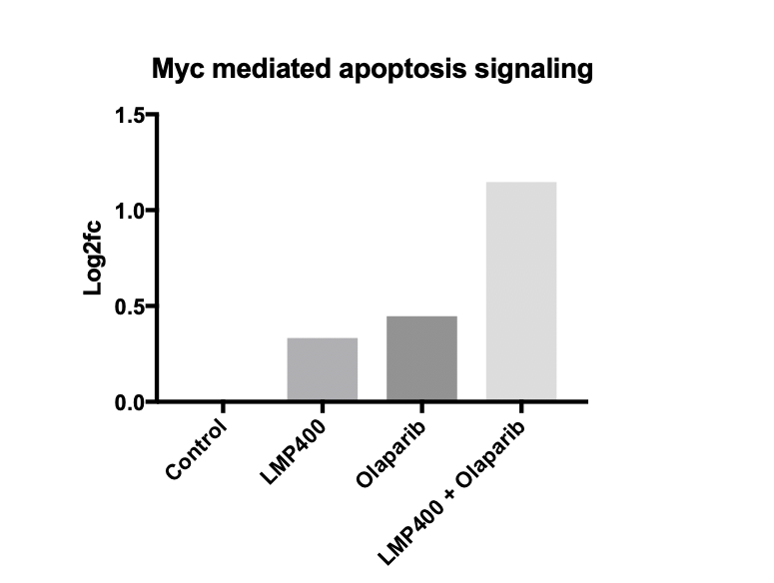
IPA analysis (GSC923)
For example, how to interpret these results for apoptosis?
 | LMP vs. Control | Ola vs. Control | LMP+Ola vs. Control
Myc Mediated Apoptosis Signaling | 0.333 | 0.447 | 1.147
 | LMP vs. Control | Ola vs. Control | LMP+Ola vs. Control
Apoptosis Signaling | 2 | 2 | 1.671

Slide 7
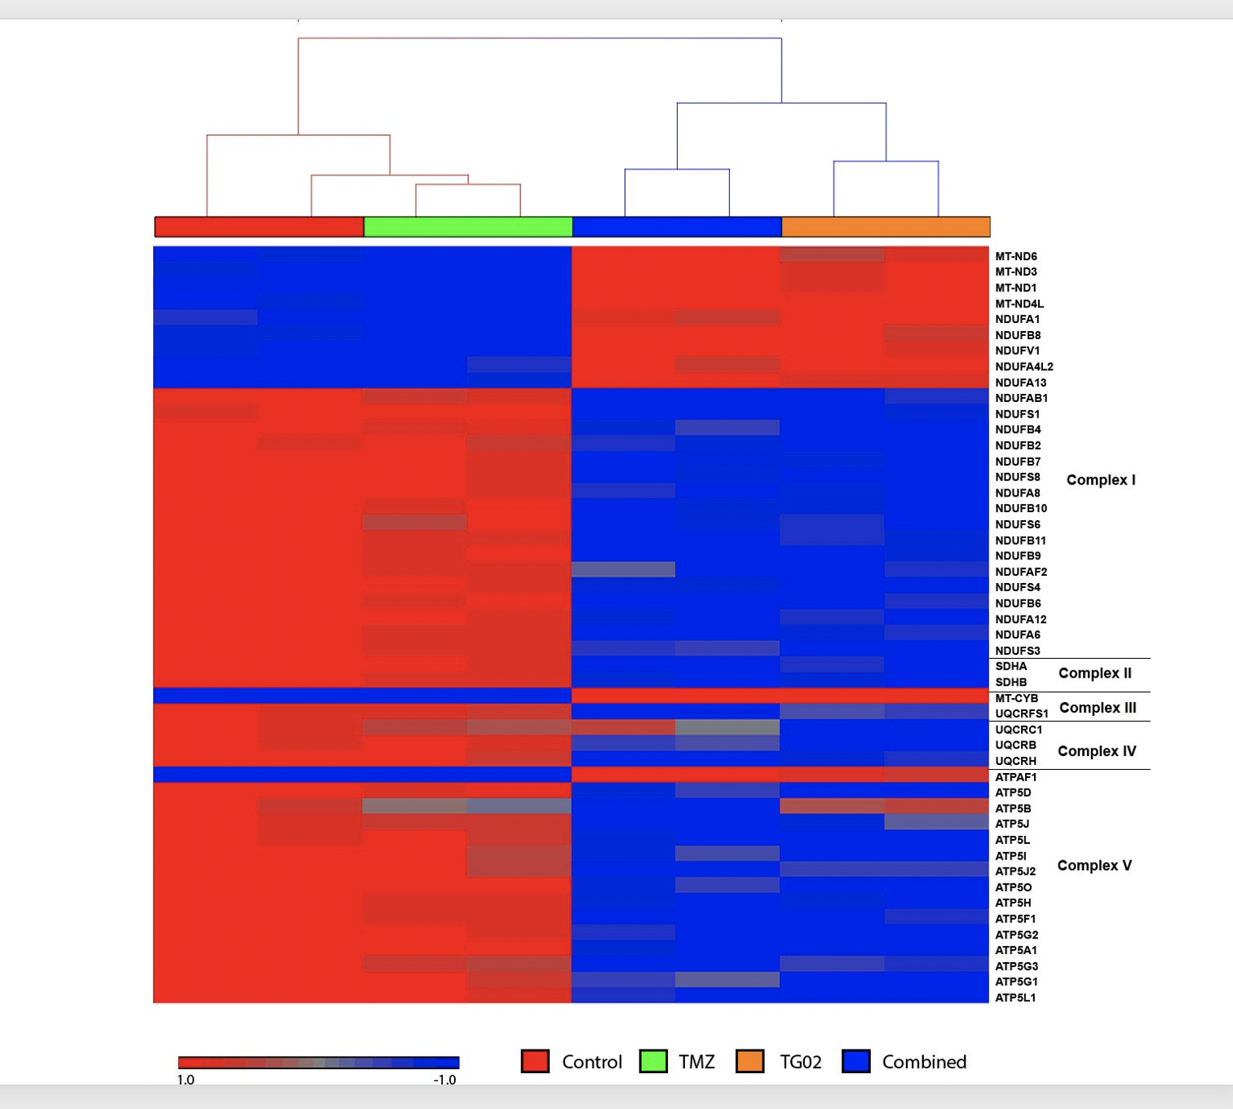
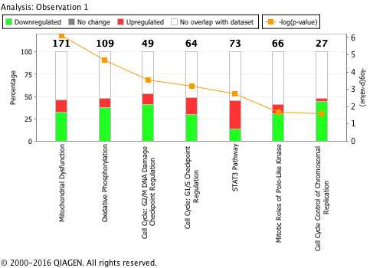
Example figures from TG02 project
Can we follow this format to show our results from the LMP400 + Olaparib analysis?
Goal: Find top pathways and demonstrate in a way similar to these figures
Remaining question: How to compare WT (GSC) vs. Mutant (SF)?

